Slide 1
CAREERS IN THE SOUTH AFRICAN POLICE SERVICE
PRESENTED BY: Section: Career Development

Slide 2
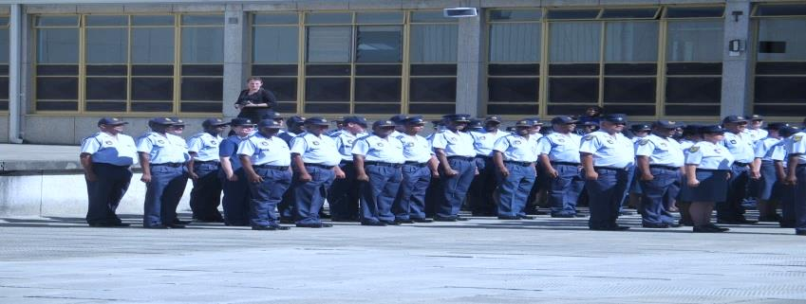

Careers in the SAPS
Making SAPS your employer of choice!

Slide 3
VISION
Secure safe environment for all the people of South Africa

Slide 4
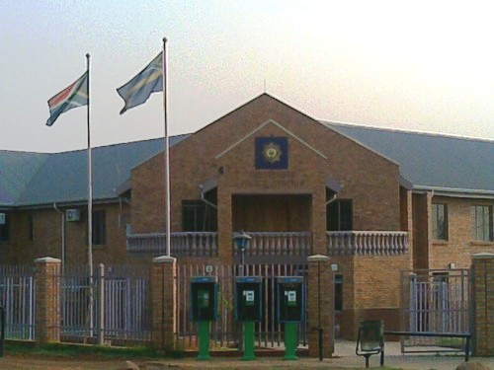
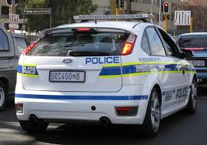
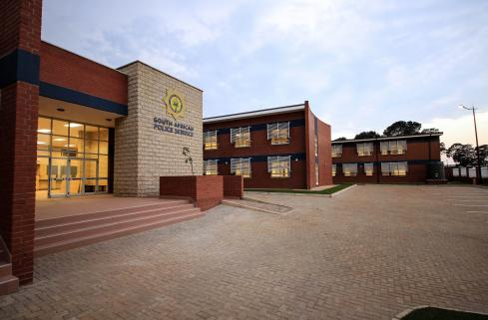
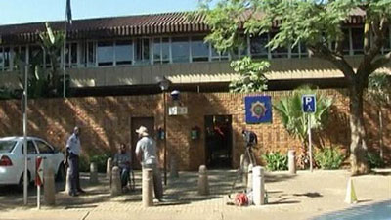
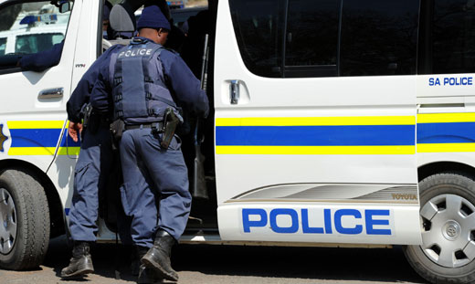
CAREERS IN THE SOUTH AFRICAN POLICE SERVICE
More about the SAPS
National Level
Provincial Level
Police Station Level

Slide 5
CAREERS IN THE SOUTH AFRICAN POLICE SERVICE
Rank structure

Slide 6
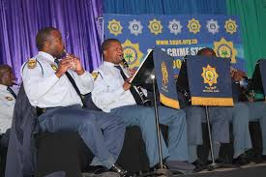

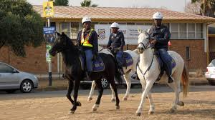
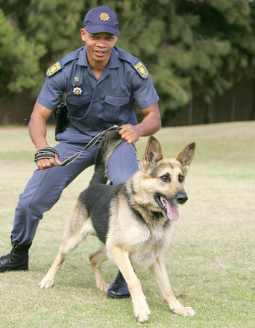
CAREERS IN THE SOUTH AFRICAN POLICE SERVICE
Career Streams in the SAPS
Functional
Entry:
Police Trainee
Specialised units
Forensic analyst, pilot, internal auditor
Support
Admin clerk, typist, personnel officer

Slide 7
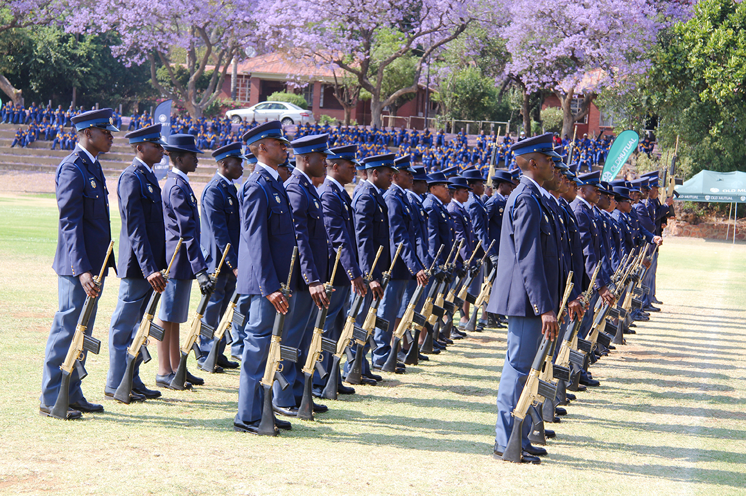
CAREERS IN THE SOUTH AFRICAN POLICE SERVICE
Police Trainees
BASIC ENLISTMENT REQUIREMENTS
(SA POLICE ACT ,1995)
Between eighteen (18) and under thirty (30) years of age
Be in possession of a Senior Certificate or National Certificate (Vocational) Safety in Society
Be proficient in at least English and one other official language;
Have no previous criminal convictions and such person shall allow his or her fingerprints to be taken and allow background enquiries to be made;
Be in possession of a valid driving license for at least a light motor vehicle;
Not have any tattoo marks of which will be visible and irreconcilable with the objectives of the Service;
Be prepared to take the oath of office;
Complete a physical and medical examination;
Undergo a psychological assessment;
Be prepared to undergo such training as determined by the National Commissioner; and
Be prepared to serve anywhere in the Republic.

Slide 8

CAREERS IN THE SOUTH AFRICAN POLICE SERVICE
Application and Selection process
APPLY:
Posts for Police trainees are advertised in the media (Newspapers) and on the official website of the SAPS (www.saps.gov.za)
Complete application form
Submit application form in accordance to the advertisement
SELECTION:
psych assessment
fitness & fingerprints
interview
medical testing
training
appointment

Slide 9

CAREERS IN THE SOUTH AFRICAN POLICE SERVICE
Advertisements: SAPS Website: www.saps.gov.za
Home
Careers
Senior Management
Police Act
Public Service Act
Police Trainees
Police Trainees
Job Title | Remuneration Level | Location | Closing Date
No post

Slide 10
CAREERS IN THE SOUTH AFRICAN POLICE SERVICE
Training information for police trainees
NEW CLASS OF POLICE OFFICERS JOINS THE FIGHT AGAINST CRIME
SAPS Academies throughout the country
Basic Police Development Learning Programme (BPDLP).
Academic and practical training

Slide 11
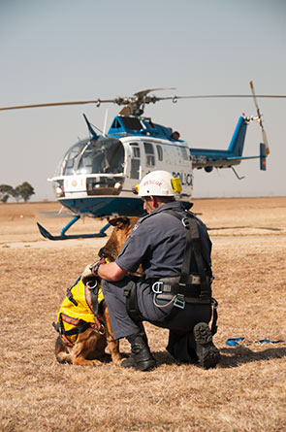
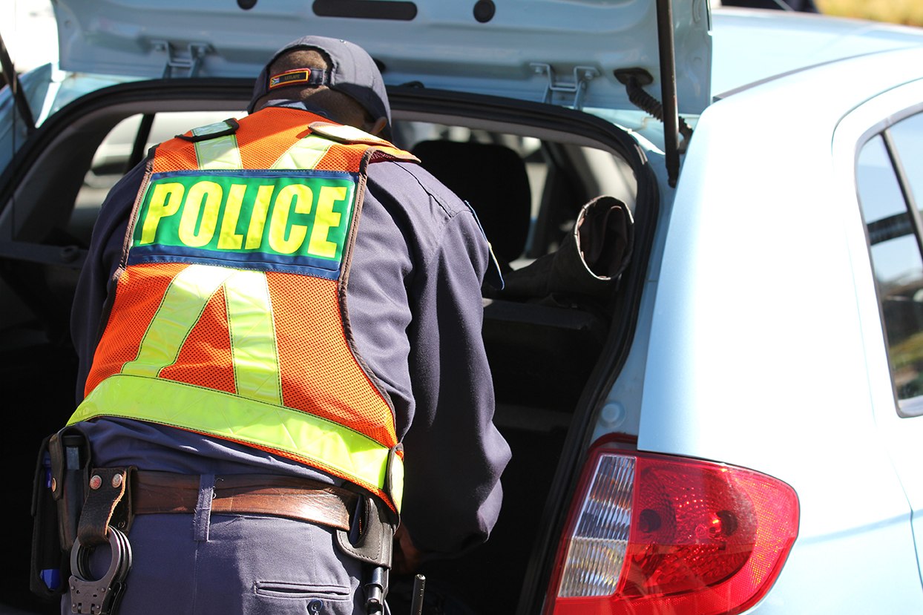
Career Development Services: SAPS
The SAPS renders the following Career Development Services:
Individual Career Discussions and advice to internal and external clients
Participation in career exhibitions, career expos and related events
Career information sessions, career exhibitions and outreach programmes at schools, FET Colleges and tertiary institutions
Walk-in and mobile career centres on provincial level
Employees have access to on-going training according to the Workplace Skills Plan
Provision of bursaries, learnerships and internships
Career information material: Career guides, Career pamphlets and SAPS Career DVD

Slide 12
CAREERS IN THE SOUTH AFRICAN POLICE SERVICE
Questions and discussions

Slide 13
Thank you

